Slide 1
Topic 3: Data Visualisation Introduction to Bar Charts
MM106/BM110
Connor Watret
connor.watret@strath.ac.uk

Slide 2
When to use a bar chart
Bar plots (or bar charts) are used when you have a number of samples which fall into categories i.e. categorical data.
The main focus of interest when using a bar chart is the relative size of each category - size might refer to the number of observations in each category, or it might be the average in each category. You might have seen these in the context of voter polls and surveys.

Slide 3
Iris Data Set
R has a number of built in data sets, this week we are going to use the iris data set in R.
To access the iris data set in R
# open the iris data set
data(iris)
Once you have done this the iris data set will appear in your Global Environment.

Slide 4
R Help
You may have noticed that beside Files, Packages etc there is a button that says Help. This allows you to access the R help file. We have introduced the iris data set, but you may want more information on the data set - so how do you get it ?
  # more information on the iris data set
  ?iris
If you type a ? followed by an R command or function, then it will automatically open the R help functionality.

Slide 5
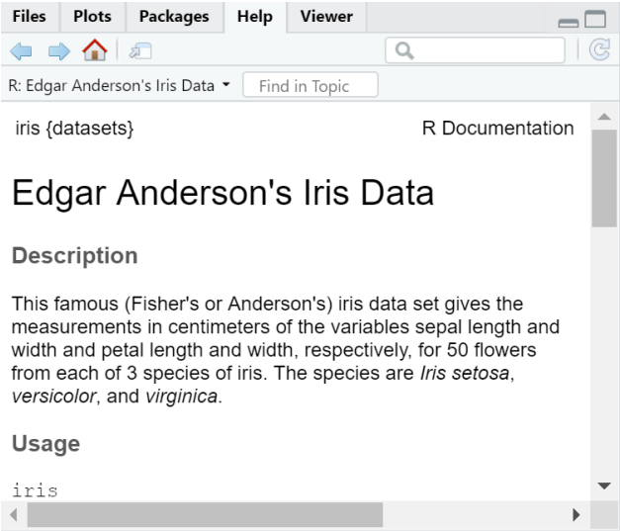
R help - Iris Dataset

Slide 6
Iris Dataset
iris is a data frame with 150 cases (rows) and 5 variables (columns) named Sepal.Length, Sepal.Width, Petal.Length, Petal.Width, and Species.
What is a sepal?
The sepal is the outer parts of the flower (often green and leaf-like) that enclose a developing bud.

Slide 7
Create a bar plot of the iris data set
The only categorical variable in the iris data set is Species.
  # The table function will compute a cross tabulation
  # of the number of observations in each category. The
  # barplot function does not count the data for you so
  # you need to tell R how many of each thing there are,
  # that is what the table command is doing.
  species data <- table(iris$species)
  species_data
  setosa versicolor virginica
  50 50 50
We can see that there are 3 species of iris and each species has 50 observations in the data set.

Slide 8
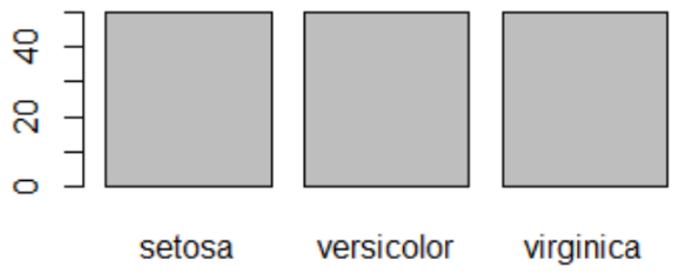
Create a bar plot of the iris data set cont...
# Create barplot
barplot(species data)

Slide 9
Create a bar plot of the iris data set cont...
The plot on the previous slide is a bit boring. There are a number of problems with this plot.
there are no axis labels on the x and y axis
the scale on the y axis is not informative

Slide 10
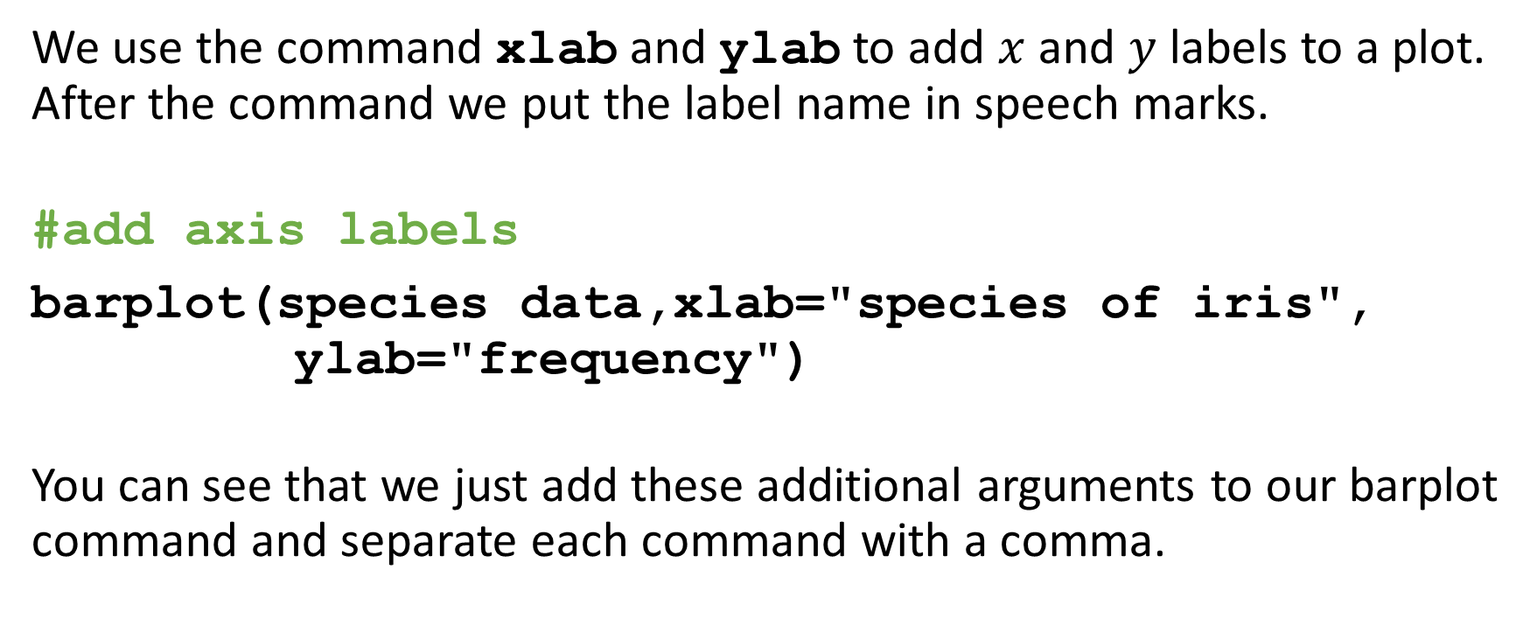
Add axis labels to a plot
We use the command xlab and ylab to add $x$ and $y$ labels to a plot. After the command we put the label name in speech marks.
#add axis labels
barplot(species data,xlab="species of iris", ylab="frequency")
You can see that we just add these additional arguments to our barplot command and separate each command with a comma.

Slide 11
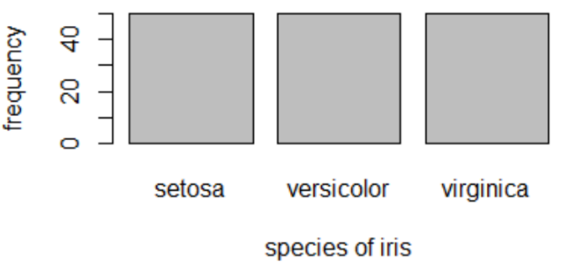
Add axis labels to a plot cont...

Slide 12
Extending the y axis
We use the command ylim to extend the y axis of our plot. The ylim function takes in a vector so we will need to use our c notation. The vector contains 2 numbers, the first is where you want the y-axis to start at (generally this is 0). The second number is the upper limit, always add a bit extra on to this value. Recall our maximum number of observations is 50, so we will make our second number in the vector 60.
  #extend y-axis
  barplot(species data,xlab="species of iris", ylab="frequency", ylim=c(0,60))

Slide 13
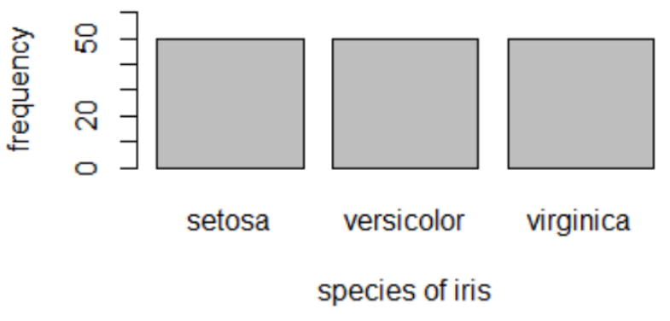
Extending the y axis cont...

Slide 14
Let’s add some colour
The chart is a boring with just grey bars, let’s shade those in. R has lots of predefined colours. We use the col function e.g. col="blue". This means that all the bars will be blue.
  #colour each bar blue
  barplot(species data,xlab="species of iris", ylab="frequency", ylim=c(0,60), col="blue")

Slide 15
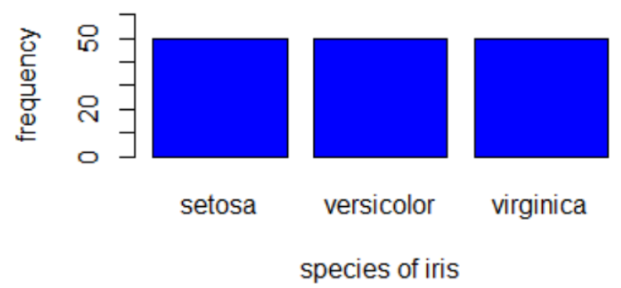
Let’s add some colour cont...

Slide 16
Let’s add some colour cont...
If you want each bar to be a different colour, then just list the colours that you want in order. The number of colours in your list needs to match the number of bars. We have 3 bars so need to define three colours.
#give each bar a different colour
barplot(species data, xlab="species of iris", ylab="frequency", ylim=c(0, 60), col=c("lightslateblue","purple","orange"))

Slide 17
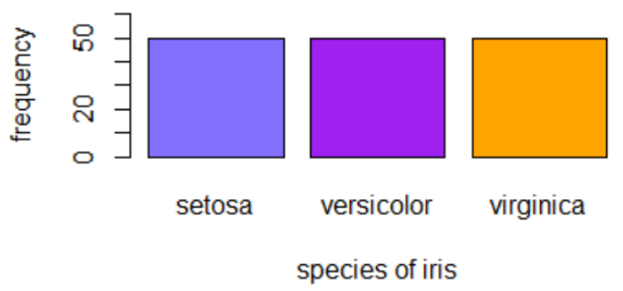
Let’s add some colour cont...

Slide 18
Tips on Creating Effective Charts
Avoid cluttered charts and graphs.
Label everything to avoid ambiguity i.e. label axis with units (if appropriate).
Remember when visualising data, you want to make the reader/viewer’s reading experience as easy as possible.

